Slide 1
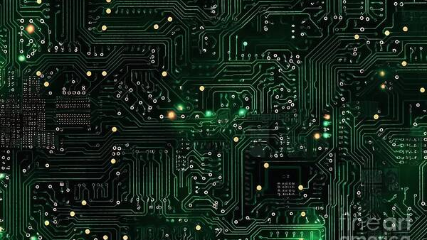
ICT WEEK 3
APPLICATIONS OF INFORMATION
AND COMMUNICATION TECHNOLOGIES
Input, Output & Storage Devices
Week 3 | Lectures 5 & 6

Slide 2
ICT WEEK 3
Session Overview
01
02
03
04
Input Devices
Direct Data Entry
Output Devices
Storage Devices
Keyboard, pointing devices, remote control, joystick, touch screen, scanners, cameras, microphones, and sensors
Magnetic stripe reader, chip and PIN, RFID, OMR, OCR, bar code reader, and QR scanner
Monitors, touch screen, multimedia projector, printers, plotter, 3D printers, speakers, and actuators
Magnetic, optical, and solid-state storage — characteristics, uses, advantages, and disadvantages
02

Slide 3
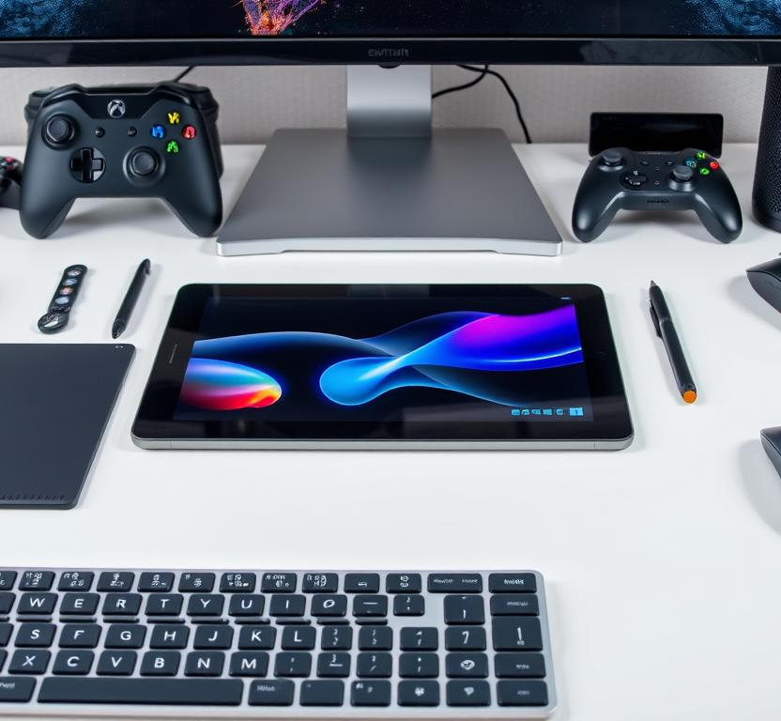
ICT WEEK 3
01
Input Devices
How Humans Communicate with Computer Systems

Slide 4

ICT WEEK 3
Keyboard & Numeric Keypad
Keyboard
The most common input device for entering text, numbers, and commands. Uses the QWERTY layout with:
Function keys (F1–F12) for shortcuts
Control keys (Ctrl, Alt, Shift) for combinations
Special keys (Enter, Tab, Esc) for navigation
Numeric Keypad
A compact 17-key input device for fast numerical data entry in accounting, banking, and POS systems. Available as integrated or standalone units.
● Modern variants include wireless, ergonomic, mechanical, and backlit designs
04

Slide 5
ICT WEEK 3
Pointing Devices
Mouse
Trackball
Optical/laser sensors detect movement. Available as wired, wireless (Bluetooth/RF), and ergonomic designs.
Stationary device with a rotating ball. User moves the ball to control the cursor. Ideal for limited desk space.
Touchpad
Graphics Tablet
Flat, touch-sensitive surface built into laptops. Supports multi-finger gestures: scroll, zoom, and swipe.
Used by designers to draw directly into digital form. Converts analog pen movements into digital signals.
Key Insight
Pointing devices provide an intuitive interface by converting physical gestures into machine-readable input. The mouse remains the most common, but alternatives like trackballs and graphics tablets serve specialized needs.
05

Slide 6
ICT WEEK 3
Remote Control, Joystick & Driving Wheel
Remote Control
Joystick
Driving Wheel
Wireless input device using infrared (IR) or radio frequency (RF) signals to operate devices from a distance.
Common in TVs, presentation systems, and smart home devices.
A lever-based input device used for gaming, CAD, and flight simulation.
Uses pressure and directional movement to control on-screen actions with precision.
Steering wheel controller with pedals that simulates real driving for racing games.
Provides force feedback for realistic handling and immersion.
Applications & Use Cases
These specialized input devices enhance user experience in entertainment, simulation, and accessibility applications. Joysticks are essential for flight simulators and gaming, while driving wheels provide realistic training for professional drivers. Remote controls remain the primary interface for consumer electronics.
06

Slide 7

ICT WEEK 3
Touch Screen as an Input Device
A display screen that also functions as an input device, allowing users to interact directly by touching icons, buttons, and on-screen elements.
Touch Technologies
Technology | How It Works | Key Feature
Resistive | Pressure-sensitive layers | Works with stylus/gloves
Capacitive | Detects electrical properties of skin | Multi-touch support
Infrared | IR light grid detection | Durable, no overlay needed
SAW | Surface acoustic waves | High clarity and precision
Common Applications
Smartphones, tablets, ATMs, self-service kiosks, POS terminals, interactive whiteboards, automotive dashboards, and industrial control panels
07

Slide 8
ICT WEEK 3
Scanners & Cameras
Scanner
Digital Camera
Converts physical documents/images into digital format.
Flatbed — high-quality photo scanning
Document — sheet-fed for bulk processing
Portable — compact/mobile scanning
3D Scanner — captures object geometry
Captures still images and video in digital format for photography, video conferencing, content creation, and surveillance.
Webcam
Small digital video camera (USB or built-in) for video calls, live streaming, and facial recognition.
Modern Integration
Smartphones combine scanner functionality (document scanning apps) with high-resolution cameras, blurring the line between dedicated and multi-purpose devices.
08

Slide 9
ICT WEEK 3
Microphone & Sensors
Microphone
Sensors
Converts sound waves into digital signals for voice recording, video conferencing, voice commands, and speech recognition.
Types: Condenser (studio), Dynamic (live), Lavalier (clip-on), USB (plug-and-play), Headset
Input devices that detect and respond to physical stimuli from the environment, converting them into digital signals.
Common Sensor Types
Temperature — measures heat levels
Motion (PIR) — detects movement
Proximity — senses nearby objects
Light — measures illumination
Pressure — detects force applied
Accelerometer / Gyroscope — orientation
Biometric — fingerprint, iris scan
● Sensors are the foundation of the Internet of Things (IoT)
09

Slide 10
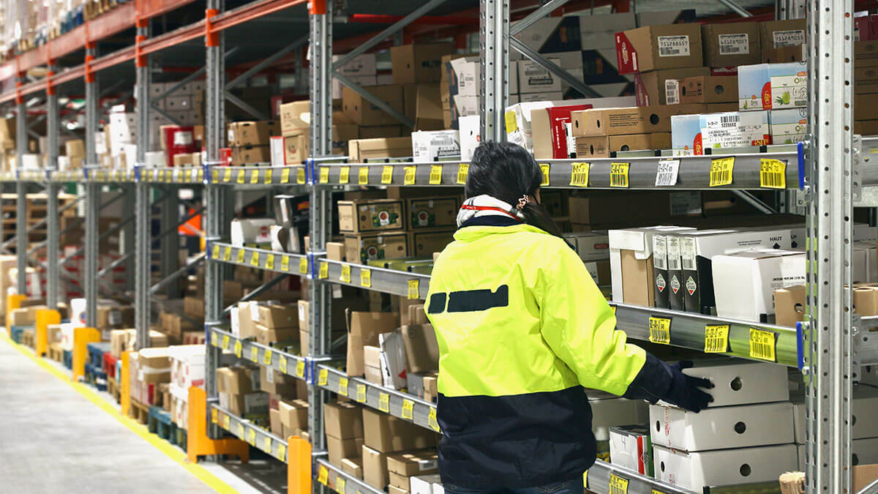
ICT WEEK 3
02
Direct Data Entry
Automated Data Capture Technologies

Slide 11
ICT WEEK 3
Magnetic Stripe Reader & Chip and PIN
Magnetic Stripe Reader
Chip and PIN Reader
Reads encoded data from the magnetic stripe on cards. Data stored in three tracks containing account numbers and verification codes.
Applications:
Retail POS terminals
Banking and ATMs
Hotel access cards
Transportation ticketing
Reads data from an embedded microchip on the card. The chip stores encrypted data and requires a PIN for authentication.
Advantages:
Dynamic data authentication
Significantly reduced card fraud
More secure than magnetic stripes
Supports contactless payments
● EMV (Europay, MasterCard, Visa) chip technology is the global standard; contactless NFC payments represent the next evolution.
11

Slide 12
ICT WEEK 3
Radio Frequency Identification (RFID)
Uses radio waves to automatically identify and track tags attached to objects. Consists of a reader and a tag.
RFID Tag Types
Type | Power Source | Range | Use Case
Passive | Reader's signal | Short (few m) | Retail, access cards
Active | Internal battery | Long (100m+) | Fleet, cargo tracking
Semi-Passive | Battery + reader | Medium | Cold chain, medical
Real-World Applications
Retail: Walmart, Zara, Uniqlo — inventory and checkout
Access: Disney MagicBands, Tesla key cards
Logistics: Delta airline baggage tracking
Healthcare: Equipment and medication tracking
60%+ of retailers plan to implement RFID by 2026
12

Slide 13
ICT WEEK 3
OMR & OCR
Optical Mark Recognition
Optical Character Recognition
(OMR)
(OCR)
Detects marks made in predefined positions on paper using reflected light.
Applications:
Standardized multiple-choice exams
Surveys and questionnaires
Census form processing
Ballot counting systems
● Fast, accurate, and cost-effective for high-volume form processing
Converts printed or handwritten text into machine-readable digital text.
Applications:
Digitizing printed books and documents
Automated data entry systems
License plate recognition
Text-to-speech for accessibility
● Modern AI-powered OCR achieves near-human accuracy
13

Slide 14
ICT WEEK 3
Bar Code Reader & QR Scanner
Bar Code Reader
QR Scanner
Uses laser or LED light to scan barcodes — parallel lines of varying widths representing numeric data.
Types: Handheld, fixed-mount, pen/wand readers
Applications:
Retail product identification (UPC/EAN)
Inventory management
Library book tracking
Healthcare patient/medication ID
Reads Quick Response (QR) codes — 2D matrix barcodes storing URLs, text, contact info, and payment data.
Applications:
Mobile payments and digital wallets
Marketing campaigns and ticketing
Restaurant menus and Wi-Fi sharing
Product authentication
● QR codes store ~100x more data than barcodes and can be read from any angle
14

Slide 15
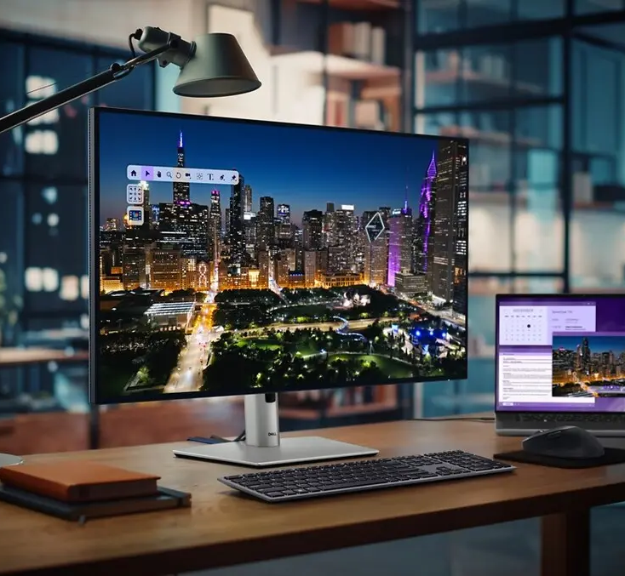
ICT WEEK 3
03
Output Devices
How Computers Present Information to Users

Slide 16
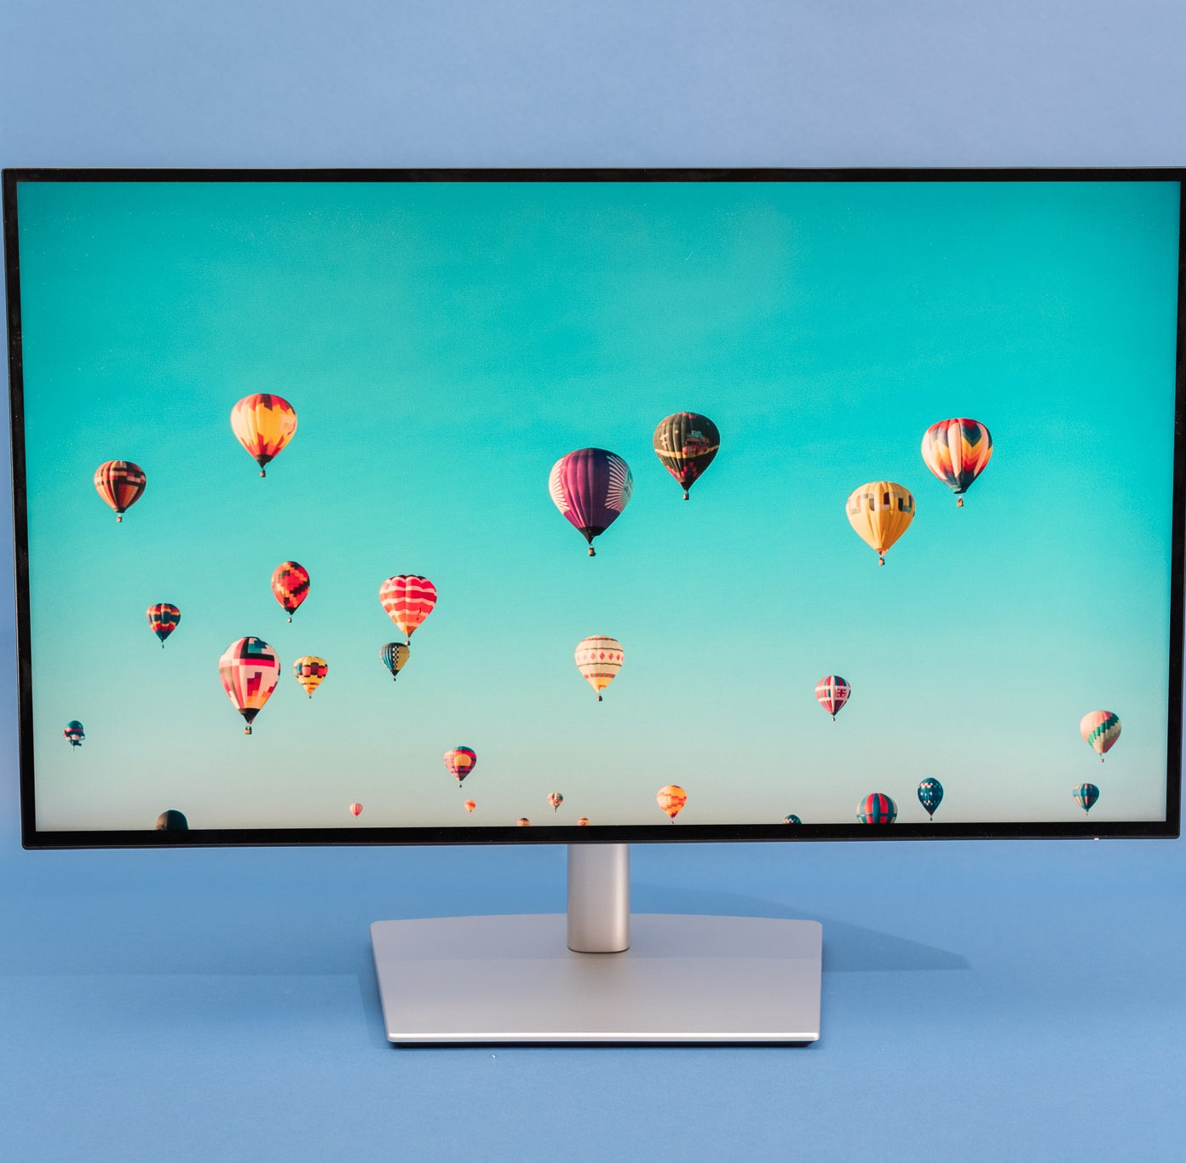
ICT WEEK 3
Monitors & Touch Screen as Output
Monitor (VDU) — Primary output device displaying visual information composed of pixels in a rectangular grid.
Display Technologies
Type | Technology | Key Features
CRT | Cathode Ray Tube (electron beams) | Bulky, obsolete, high refresh rate
LCD | Liquid crystals + backlighting | Thin, energy-efficient, affordable
LED | LED-backlit LCD | Better contrast, thinner, low power
OLED | Organic self-emitting LEDs | Superior color, deep blacks, flexible
Key Specifications
Resolution: Full HD (1920x1080), 4K, 8K | Refresh Rate: 60Hz–240Hz | Size: 15"–49"+
● Touch Screen as Output: Displays visual feedback in response to touch input
16

Slide 17
ICT WEEK 3
Multimedia Projector
An optical output device that projects enlarged images and video onto a large screen or wall surface. Essential for presentations, education, and entertainment.
Projection Technologies
DLP
LCD Projection
Laser Projection
Digital Light Processing uses millions of micro-mirrors to reflect light. Sharp images, high contrast, reliable.
Uses liquid crystal panels to filter light. Accurate color reproduction, energy-efficient, widely available.
Uses laser light sources for enhanced brightness, instant on/off, and extended lamp life (20,000+ hours).
Applications & Key Specs
Applications: Classroom teaching, business presentations, home theater, conference halls, outdoor events, digital signage
Key Specifications: Brightness (lumens), Resolution (XGA to 4K), Throw ratio, Contrast ratio, Lamp life
● Modern projectors support wireless connectivity and interactive touch capabilities
17

Slide 18
ICT WEEK 3
Printers — Laser, Inkjet & Dot Matrix
Laser Printer
Inkjet Printer
Dot Matrix
Uses laser beam and toner powder to produce high-quality output.
Speed: 20–70 ppm
Cost: Low per page
Pros: Fast, sharp text, efficient
Cons: Higher upfront cost
Best for: Offices, high-volume text
Sprays tiny droplets of liquid ink onto paper.
Quality: Excellent photos
Cost: Affordable initial price
Pros: Photo quality, color, versatile media
Cons: Slower, expensive ink
Best for: Photos, creative work
Pins strike an ink ribbon to create characters.
Feature: Multi-layer forms
Cost: Very low operating cost
Pros: Carbon copies, durable, cheap
Cons: Loud, low quality, slow
Best for: Receipts, invoices, forms
● Selection depends on use case: Laser for offices, Inkjet for photos, Dot Matrix for multi-part forms
18

Slide 19
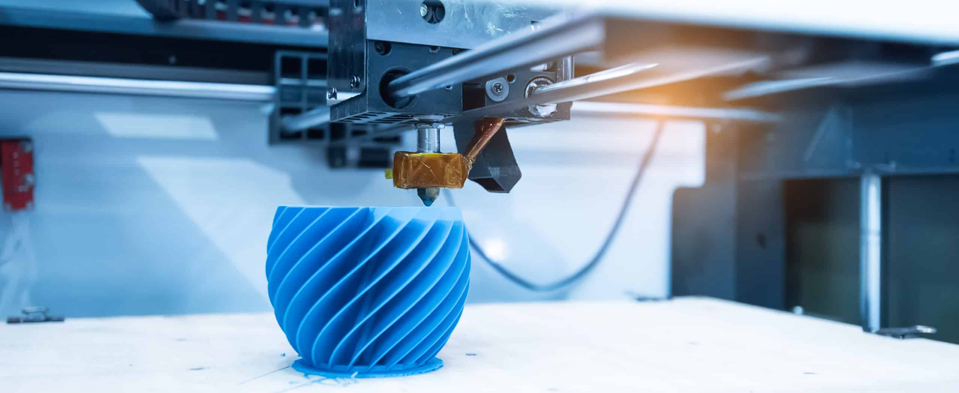
ICT WEEK 3
Plotter & 3D Printers
Plotter
Specialized printer for large-format, high-precision output such as blueprints, maps, engineering drawings, and posters.
Uses pens or cutting blades on paper/vinyl. Types include drum, flatbed, and cutting plotters.
3D Printer
Applications
Creates physical 3D objects from digital models using additive manufacturing — building layer by layer.
Healthcare: Custom implants, prosthetics, surgical guides
Manufacturing: Rapid prototyping, tooling
Education: Hands-on learning models
Aerospace: Lightweight complex parts
Automotive: Custom components
3D Printing Technologies
FDM — melted filament | SLA — UV-cured resin | SLS — laser-fused powder
19

Slide 20
ICT WEEK 3
Speaker & Actuator
Speaker
Actuator
Converts electrical audio signals into sound waves.
Types:
Built-in computer speakers
Standalone / Studio monitors
Bluetooth/wireless speakers
Headphones and headsets
Applications: Music, video, voice assistants, gaming, alerts
Converts electrical signals into physical motion — the "muscles" of a control system.
Types:
Linear actuators (straight-line motion)
Rotary actuators (circular motion)
Servo motors (precise positioning)
Solenoids (electromagnetic motion)
Uses: Robotics, CNC, vehicles, smart home
● Actuators bridge the gap between digital commands and physical world actions in automation and IoT
20

Slide 21
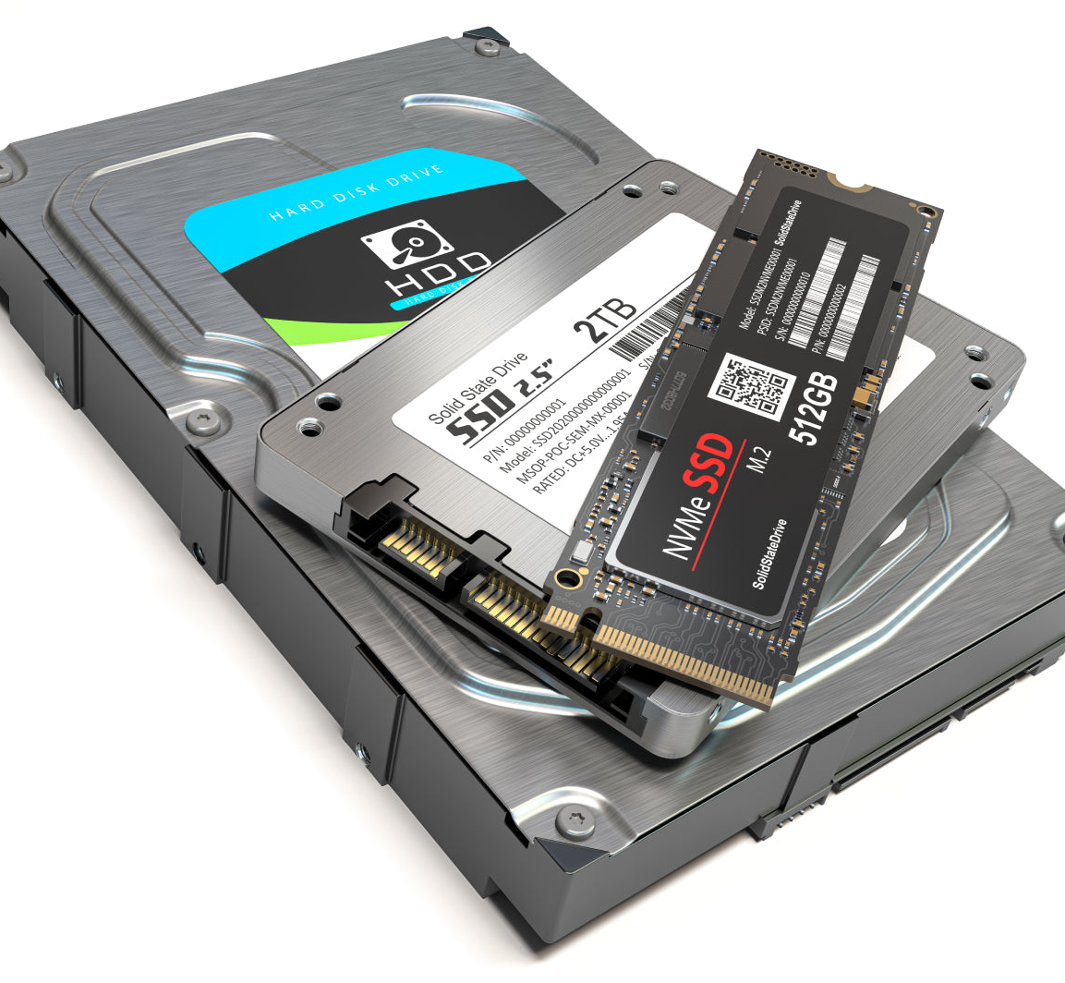
ICT WEEK 3
04
Storage Devices
Media, Characteristics & Comparisons

Slide 22
ICT WEEK 3
Storage Device Characteristics
Storage devices retain data even when power is removed (non-volatile). The following characteristics determine the right storage for each use case:
Capacity
Speed
Portability
Durability
Amount of data held (GB, TB)
Read/write access time and transfer rate
Ease of transport between devices
Resistance to damage and environment
Cost per GB
Reliability
Power Use
Price relative to storage amount
MTBF and data longevity
Energy required for operation
Three Main Categories
Magnetic Storage
Optical Storage
Solid-State Storage
22

Slide 23
ICT WEEK 3
Magnetic Storage — Hard Drives & Tape
Fixed Hard Disk (HDD)
Portable Hard Drive
Magnetic Tape
Non-removable magnetic storage with spinning platters and read/write heads.
Capacity: 500GB – 20TB+
Advantages:
High capacity
Low cost per GB
Established, reliable technology
Disadvantages:
Moving parts (failure risk)
Slower than SSD
Sensitive to shock
Generates heat and noise
External HDD connected via USB in a portable enclosure.
Interface: USB 3.0 / USB-C
Advantages:
Large capacity
Affordable
Plug-and-play
Disadvantages:
Requires careful handling
Slower than SSD
Vulnerable to drops
Sequential-access storage on tape reels for backup and archival.
Capacity: LTO-9: 18TB native
Advantages:
Extremely high capacity
Very low cost per GB
30+ year archival life
Disadvantages:
Very slow (sequential only)
Requires special equipment
Degrades over time
23

Slide 24
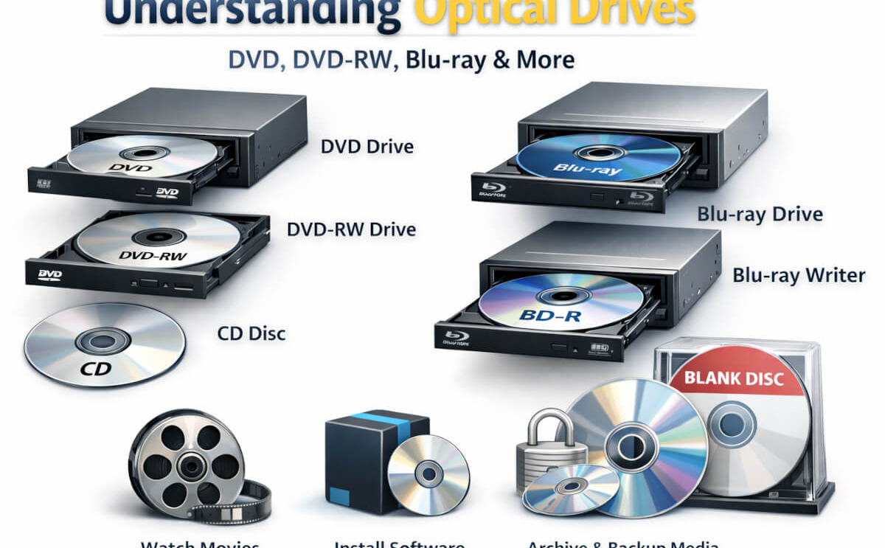
ICT WEEK 3
Optical Storage — CD, DVD & Blu-ray
Uses laser technology to read/write data as pits and lands on a reflective disc surface.
Format | Capacity | Primary Use | Status
CD | 700 MB | Audio, small data backup | Largely obsolete
DVD | 4.7 – 8.5 GB | Movies, software, archiving | Declining use
Blu-ray | 25 – 100+ GB | HD movies, games, archiving | Niche use
Types | ROM / R / RW | Read-only, recordable, rewritable | Various formats
Advantages
Disadvantages
Low cost per GB
No moving parts in the disc
Portable and silent operation
Low capacity vs. HDD/SSD
Slow read/write speeds
Prone to scratches
Becoming obsolete
24

Slide 25
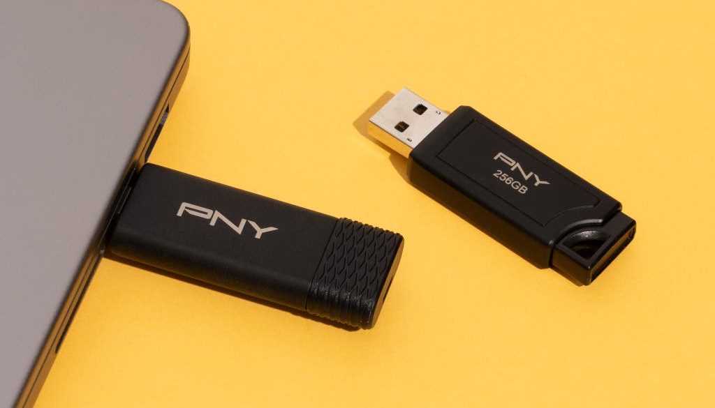
ICT WEEK 3
Solid-State Storage — SSD, Pen Drive & Flash
Uses flash memory chips with no moving parts. Faster, more durable, and more energy-efficient.
Fixed SSD
Pen / Flash Drive
Replaces internal HDD. Capacities: 256GB – 4TB+
Pros: Very fast boot (10–13s), silent, shock-resistant, low power
Cons: Higher cost per GB, limited write cycles
Small plug-and-play device. Capacities: 8GB – 1TB
Pros: Highly portable, affordable, durable
Cons: Easy to lose, slower than fixed SSD
Market Trend
SSD prices have dropped dramatically and are now the default choice for primary storage in laptops and desktops. Portable SSDs via USB-C/Thunderbolt are ideal for video editing and professional workflows.
10–13s
SSD boot time vs. 30–40s for HDD
200–550 MB/s
SSD file copy speed vs. 50–120 MB/s for HDD
25

Slide 26
ICT WEEK 3
Storage Device Comparison
Characteristic | Magnetic | Optical | Solid-State
Capacity | Very High (up to 20TB+) | Low (700MB – 100GB) | High (up to 4TB+)
Speed | Moderate (50–200 MB/s) | Slow (read-only fast) | Very Fast (200–7000 MB/s)
Portability | Moderate (external drives) | High (small discs) | Very High (USB/compact)
Durability | Low (moving parts) | Moderate (scratches) | High (no moving parts)
Cost per GB | Very Low | Low | Moderate (decreasing)
Best For | Bulk storage, backups | Media distribution, archive | Primary storage, mobile
Power Use | High (6–7W) | Low (read only) | Very Low (2–3W)
● Hybrid approaches (SSHD — Solid-State Hybrid Drives) combine magnetic and flash storage for a balance of capacity and speed
26

Slide 27
ICT WEEK 3
Key Takeaways
1
Input devices translate human actions into machine-readable data; output devices translate processed data back into human-perceivable forms
2
Direct data entry technologies (RFID, barcode, OCR, etc.) automate data capture, improving accuracy and efficiency
3
Storage technology choice depends on balancing capacity, speed, cost, durability, and portability requirements
4
The trend across all device categories is toward faster, smaller, more efficient, and more integrated solutions
5
Understanding device characteristics enables informed technology selection for any application — from personal computing to enterprise systems
27

Slide 28

THANK YOU
Applications of Information and Communication Technologies
Week 3 | Lectures 5 & 6

